Slide 1
VISUAL C#.NET
Instructor: Edwin oduor

Slide 2

Quote of the day

Slide 3
Lesson objectives
Introduce ASP.NET MVC CORE
Setting Up Machine
Creating ASP.NET CORE Web Application
Core Project Files
Middle ware

Slide 4
Lesson pre-requisites
In order to take full advantage of this section you need to have the following;
Computer with Visual Studio Installed.
Stable Network Connection.

Slide 5
Training methods and extra readings
TRAINING METHODS FOR THIS LESSON
EXTRA READINGS
Lecturing Method – This is the main method of training to be adopted in this lesson with illustrations and practical coding examples.
Discussion Method - This method will be adopted periodically whereby learning will be derived principally from the students brainstorming together, rather than from the trainer. Three main types of discussions will be used:
Directed discussion
Developmental discussion
Problem-Solving discussion
Home and Learn C#

Slide 6
Introduce ASP.NET MVC CORE

Slide 7
What is ASP.NET MVC CORE?

Slide 8
ASP.NET core is a cross platform, high performance open source frame work that is used to build cloud based, internet connected application.
Earlier before ASP.NET Core there was ASP.NET 4.X this earlier version was not open source hence it was mostly designed to be used by Microsoft products.
While ASP.NET Core is the opposite of this it is open source and can run on different platforms i.e., Windows. Mac, Linux

Slide 9
CREATING ASP.NET MVC CORE APPLICATION?

Slide 10
Open Visual studio >> File >> New >> select the option that you want to use, In this case will use ASP.NET Core Empty >> Click Next. >> Give your project a name, location to be saved >> Next >> Uncheck configure for Http and click on create.

Slide 11
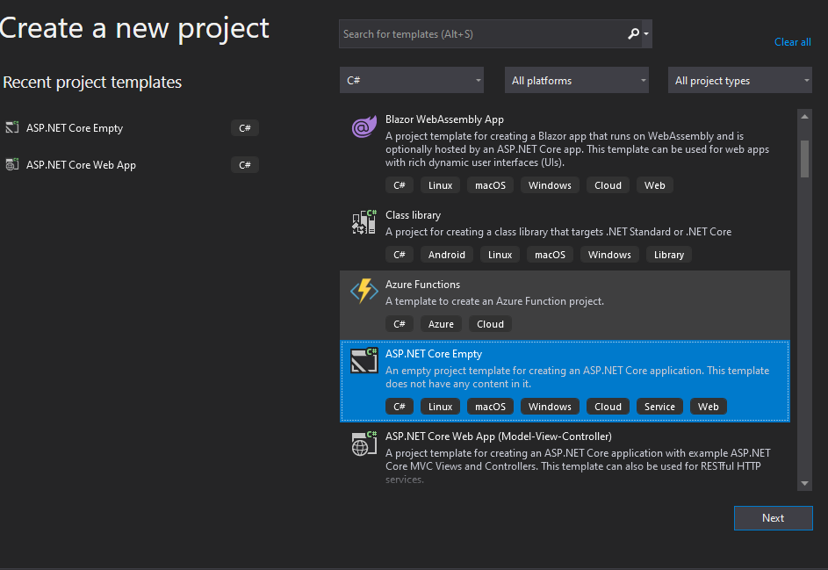

Slide 12
CORE PROJECT FILES

Slide 13
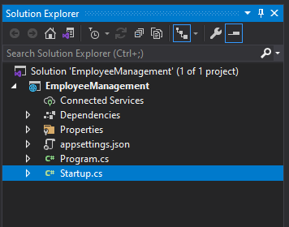
CORE PROJECT FILES
Will be talking about the files later as we proceed so that we can understand what each file does.

Slide 14
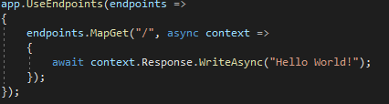
By default, when a new project is created (empty), when one runs the project it will display Hello World on the screen, to change this then double click on the startup.cs file and locate this, and change the text from Hello World to any text of your choice.

Slide 15
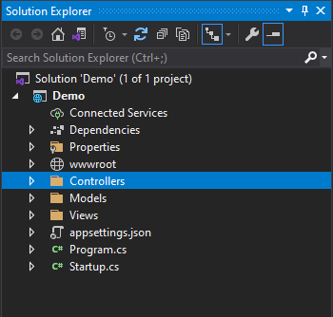
We have already created a new project, the one that we created is an empty project, the one that will create next is ASP.NET MVC Core. When an MVC Application is created in the solution explorer some additional folders will be added to the project. Will be having a look at the additional folders later.

Slide 16
Before that let’s get to understand some of the files that are shown in the Solution Explorer.
Startup.cs – This file contains the default route i.e., when the program is loaded which page to be loaded as the default. It also contains the middle ware, will understand what the term is as we continue with the session.
Program.cs – This file contains the main method. This is the Entry point when the program is executed
Appsettings.json – This file stores configuration settings for instance database connection strings.

Slide 17
MIDDLE WARE

Slide 18
Middle Ware – A middle ware is a piece of software that can handle http request and response, we can have middle wares for doing different things for instance we can have middle ware to authenticate users, serve static files i.e., JavaScript Files, HTML files, suppose we want to display an image on the browser, then will create a folder in the root file, our root file is Employee Management. Right click on it >> New Folder, the folder name give it wwwroot. When dealing with static files i.e., JS files, then they have to be placed inside the wwwroot folder.

Slide 19
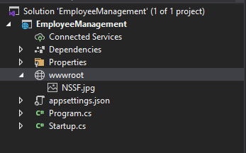
MIDDLE WARE CONTD..

